Slide 1

Web Applications – part 1
From Thick to Thin to Thick…
Trainers: Daniela-Oana BESLIU
Hanna BOTAR
Vlad Claudiu BULIMAC
Author: Viorel TACLICIU

Slide 2
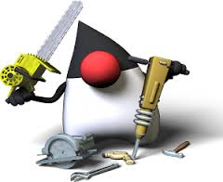

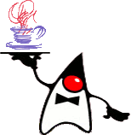


Tools
Notes:
Ingredient, o piesa a unui ansamblu.
In industria software :
Componenta este o parte complexa, aproape independenta, o parte inlocuibila a unui system si indeplineste o functie clara in contextul unei arhitecturi bine definite.

Slide 3

Contents
Web development
Containers
Java Web applications
Servlets
HttpRequest, HttpResponse, HttpSession, ServletContext, Filters, Session Listeners
Securing web applications
Putting all together
Q&A

Slide 4

Let’s go

Slide 5
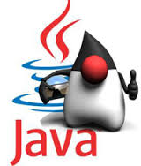
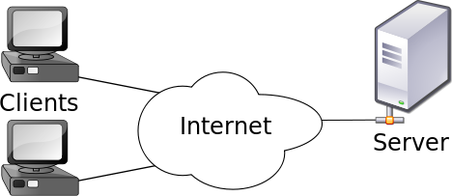
Web development
Client-server model
Is a distributed application structure that partitions tasks or workloads between the providers of services and services requesters
Client – is the part that makes a request to a service
Server – is the part that actually provides services to it’s clients. A server could also act as a client and vice versa

Slide 6

Web development
Repeated cycles - thick client to thin client, to thick…
Thick client (heavy, rich or fat client) is a computer (client) in a client – server architecture that typically provides rich functionality independent of the central server. A fat client still require a connection to a network or a server, but also has the ability to perform many functions without that connection
Thin client, in contrast, generally does a little processing
From Swing Applications to JSP/Servlets Application to Angular JS Applications
Notes:
Istoric: Cicluri intre thick (fat) client (Swing, Oracle Forms) – la thin (slim) client (JSP) - spre thick client (Angular)

Slide 7
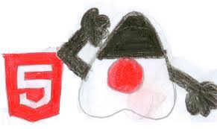
Web development
Until three years ago we developed web application using thin clients
Now we develop web application based on browser-centric HTML5 applications talking to thin-servers
Our technology stack is based on rich clients (Angular JS) and the server provides services to these clients

Slide 8

JEE Container & Web Container
are the interface between a Java component and the low-level platform-specific functionality
provide separation of business logic from resource and lifecycle management
this allows developers to focus on writing business logic rather than writing enterprise infrastructure
The Java EE platform uses "containers" to simplify development

Slide 9
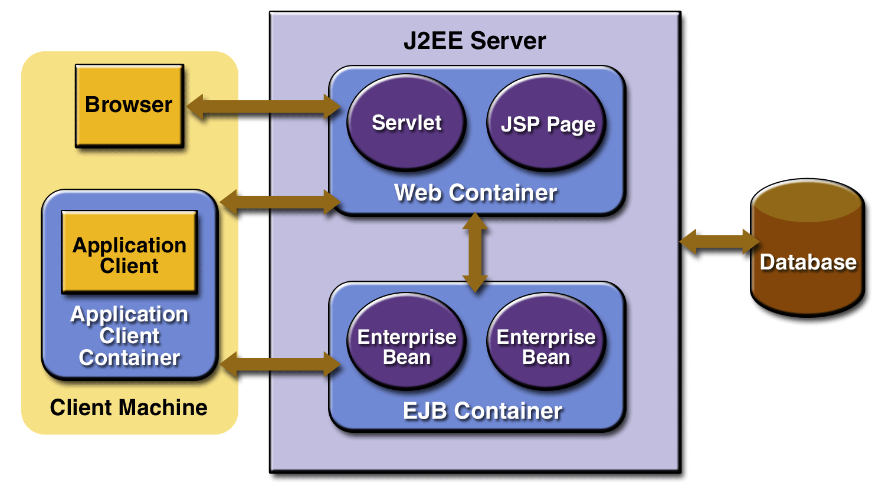
JEE Container

Slide 10
Web Container
Web container (also known as a Servlet container) is the component of a web server that interacts with Java servlets. A web container is responsible for managing the lifecycle of servlets, mapping a URL to a particular servlet and ensuring that the URL requester has the correct access rights.
A web container handles requests for servlets, Java Server Pages (JSP) files, and other types of files that include server-side code. The Web container creates servlet instances, loads and unloads servlets, creates and manages request and response objects, and performs other servlet management tasks.
A web container implements the web component contract of the Java EE architecture, specifying a runtime environment for web components that includes security, concurrency, lifecycle management, transaction, deployment, and other services.

Slide 11
Apache Tomcat
Apache Tomcat (or simply Tomcat, formerly also Jakarta Tomcat) is an open source web server and servlet container developed by the Apache Software Foundation(ASF).
Tomcat implements the Java Servlet and the JavaServer Pages (JSP) specifications from Oracle, and provides a "pure Java" HTTP web server environment for Java code to run in. In the simplest configuration Tomcat runs in a single operating system process.
The process runs a Java virtual machine (JVM). Every single HTTP request from a browser to Tomcat is processed in the Tomcat process in a separate thread.
Apache Tomcat includes tools for configuration and management, but can also be configured by editing XML configuration files.

Slide 12


Slide 13
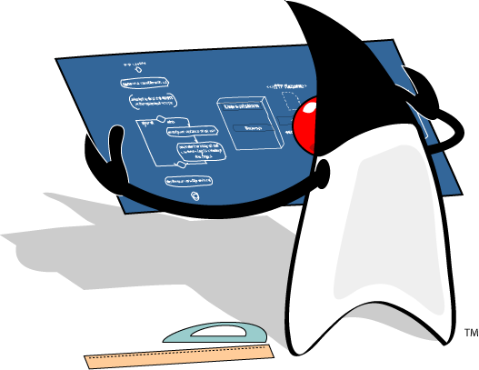
Tomcat configurations - workshop
Open Server configuration.docx
Begin workshop

Slide 14
Tomcat configurations
What are the configurations brought to our Tomcat server?
Firstly, we’ve introduced a user in tomcat-users and added a set of specific credentials, part of them will be used lately when we’ll run the maven deploy task
We’ve modified tomcat default port from 8080 to 8082
We’ve integrated our server in maven so that we can run several tomcat commands directly from maven
Stay tuned! We will bring other configurations later on!

Slide 15

Web application - archive
The web applications that are deployed in our container are archives with the “.war” extension
It is mandatory that the web archive contains the folder /WEB-INF in the structure
Under WEB-INF folder we’ll have another folder named /lib where we’ll find all the “.jar” dependencies of our web application
Under WEB-INF folder we’ll have another folder named /classes where we’ll find all the compiled classes of our application
Under WEB-INF folder we’ll find a file named web.xml, if we use the 2.x version of the Servlet API
They are portable because they are written in JAVA

Slide 16
Web applications - workshop
Open Web application.docx
Begin workshop

Slide 17
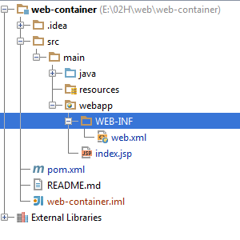
Web applications - sources
Maven standardizes the sources structure of a web application
src/main/java –JAVA classes
src/main/resources – configuration resources
src/main/web-app –web resources – jsp pages, static pages
src/main/web-app/WEB-INF – applies to the WEB-INF folder from the archive

Slide 18
Dictionary
HTTP – Hypertext Transfer Protocol – is an application protocol for distributed, collaborative, information systems. HTTP is the foundation of data communications for www. HTTP functions as a request-response protocol in the client-server computing model
URL – uniform resource locator – also known as web address, when used with HTTP – is a specific character string that constitutes a reference to a resource. Url beginning with http
A web browser, for example, may be the client and an application running on a computer hosting a web site may be the server. The client submits an HTTP request message to the server. The server, which provides resources such as HTML files and other content, or performs other functions on behalf of the client, returns a response message to the client. The response contains completion status information about the request and may also contain requested content in its message body.

Slide 19
Request – response model
Request–response or request–reply is one of the basic methods computers use to communicate to each other.
When using request–response, the first computer sends a request for some data and the second computer responds to the request.
Browsing a web page is an example of request–response communication.
One can think of request–response as being like a telephone call, where you call someone and they answer the call.

Slide 20
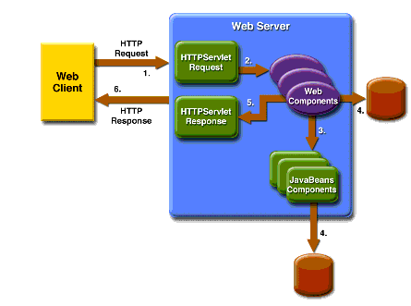
Request – response model

Slide 21
HTTP Method
The most commonly used are : GET, POST, PUT and DELETE
GET - Requests a representation of the specified resource.
Requests using GET should only retrieve data and should have no other effect.
Using GET client data is transmitted to server in URL as query strings(name/value pairs)
Query String is the part from URL that proceed “?” character
A GET Example /test/demo_form.jsp?name1=value1&name2=value2
POST – Submits data to be processed to a specified resource
Using POST data is transmitted to server in request body
POST /test/demo_form.jsp HTTP/1.1 Host: w3schools.com name1=value1&name2=value2

Slide 22
Servlet
The servlet is a Java programming language class used to extend the capabilities of a server.
Servlets can respond to any types of requests, they are commonly used to extend the applications hosted by web servers
A servlet is an object that receives request and generates response based on that request
The servlet is an interface under the javax.servlet package from servlet API
A common used implementation is javax.servlet.http.HttpServlet
You could extends this class to implement your own servlet

Slide 23
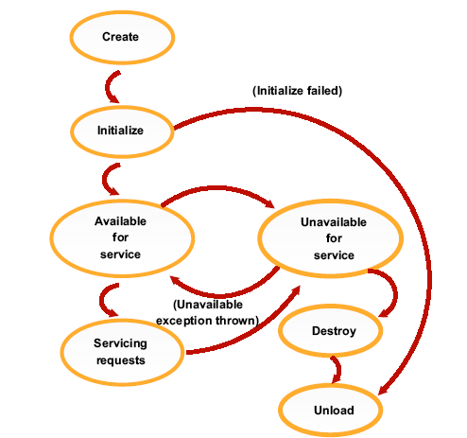
Servlet lifecycle
The server will automatically call:
public void init():
Called only once when serlvet is being
created.
Good place for set up, open Database,
etc.
public void service():
Called once for each request.
In HttpServlet, it delegates
requests to doGet, doPost, etc.
public void destroy():
Called when server decides to
terminate the servlet.
Release resources.

Slide 24
Make your own HttpServlet
public interface Servlet {…}
public abstract class HttpServlet extends GenericServlet
implements java.io.Serializable{…}
To create your own servlet you must extend HttpServlet and override doGet or doPost method
In web.xml you have to declare the servlet and map it to a url or multiple urls
<servlet>
<servlet-name>HelloWorld</servlet-name>
<description>HelloWorld Servlet</description>
<servlet-class>ro.teamnet.z2h.web.HelloWorldServlet</servlet-class>
</servlet>
<servlet-mapping>
<servlet-name>HelloWorld</servlet-name>
<url-pattern>/hello</url-pattern>
</servlet-mapping>

Slide 25
HttpServlet method
The method that you’ve overridden takes two parameters:
an HttpServletRequest object – represent request from client
an HttpServletResponse object – represent response to client

Slide 26
HttpServletRequest
Represents the client request
The mostly used methods are :
getHeaders returns all the values of the specified request
getHeaderNames returns an enumeration of all the header names
getMethod returns the http method
getQueryString returns query string
getCookies returns cookies from the client
getParameterNames returns an enumeration containing all parameters names from the client
getParameter takes an argument representing the parameter name and returns the parameter value

Slide 27
HttpServletResponse
Represents the server response
The mostly used methods are :
getWriter returns a PrintWriter object that can send character text to the client.
setContentType sets the content type of the response . If you return an html then invoke the method with “text/html” as argument value
addHeader adds a response header with the given name and value

Slide 29
Servlets - workshop
Open Servlets - 1.0.docx
Begin workshop

